Slide 1



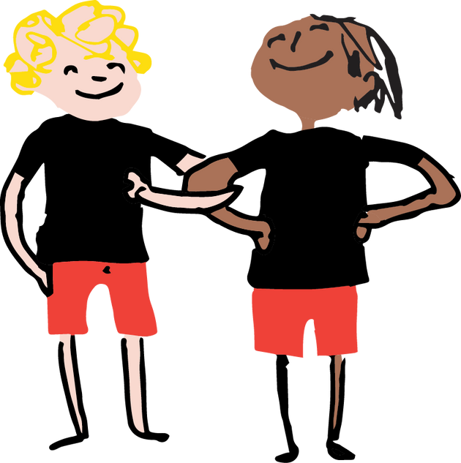
Myth-busting!
  Carers can work and we will offer flexibility.
  We welcome applications from anyone and want to actively support carers with diverse ethnicity/religious beliefs/sexuality to apply.
  You don’t have to be in a relationship, we want and need single carers.
  You are not 'just' supported by a social worker – there is a wider offer of support.

